Slide 1
CLASIFYING THE FINGERS TO RECOGNISE THE HAND GESTURES BY USING THE OPEN SOURCE COMPUTER VISION

Slide 2
Abstract:
Hand gesture recognition system is used for interfacing between computer and human using hand gesture. We wish to make a windows-based application using C++.
This project is a combination of live motion detection and gesture identification.
The user has to perform a particular gesture. The webcam captures this and identifies the gesture, recognizes it and performs the action corresponding to it.

Slide 3
Introduction:
Gesture recognition is an active research field which tries to integrate the gestural channel in Human Computer Interaction.
The representation process converts the raw numerical data into a form adapted to the decision process which then classifies the data.
Two main families of gesture acquisition systems, device-based and vision-based, can be considered.
In vision-based systems, the gesture is captured by a camera. The main advantage of the vision-based approach is its unconstrained nature.

Slide 4
Existing Method:
Threshold process
Feature extraction classification
DISADVANTAGES:
Information of image is less
Reducing the image classification accuracy

Slide 5
Proposed Method:
Neural network model
Binary Threshold
Open Cv module
ADVANTAGES:
Classification of gesture is clear
We can add the dataset
User defined requirements should be done
APPLICATIONS:
Textile Industrial areas
Gesture recognition
Medical application

Slide 6
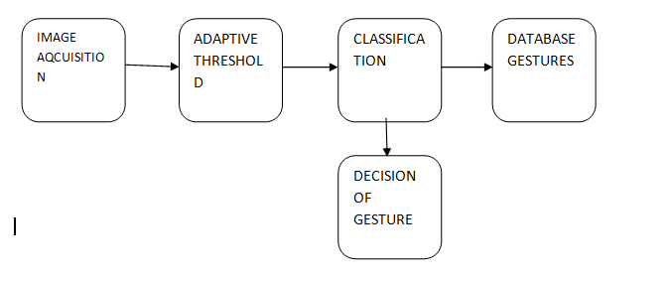
Block Diagram:

Slide 7
Explanation:
From the above block diagram take an image using image aquaization as input. Then it will divide into regions.
After that calculate binary threshold value for each regions using adaptive thresholding.
then select the most relevant features for the classification.
After that using database gesture and decision gesture we recognizes the hands Using open cv.
Finally, we can get recognize output.

Slide 8
Software And Hardware used:
SOFTWARE REQUIREMENTS:
Python, anaconda navigator.
Open CV modules.
HARWARE REQUIREMENTS:
Windows OS PC
Minimum 2GB RAM

Slide 9
References:
References
[1] Z. Zhang, Z. Tian, and M. Zhou, ‘‘Latern: Dynamic continuous hand gesture recognition using FMCW radar sensor,’’ IEEE Sensors J., vol. 18, no. 8, pp. 3278–3289, Feb. 2018.
[2] A. Bendale and T. E. Boult, ‘‘Towards open set deep networks,’’ in Proc. IEEE Conf. Comput. Vis. Pattern Recognit. (CVPR), Jun. 2016, pp. 1563–1572.
[3] Meta-Learning: Learning to Learn Fast. Accessed: May 10, 2019. [Online]. Available: https://lilianweng.github.io/lil-log/2018/11/30/metalearning.html
[4] B. M. Lake, R. Salakhutdinov, and J. B. Tenebaum, ‘‘Human-level concept learning through probabilistic program induction,’’ Science, vol. 350, no. 6266, pp. 1332–1338, 2015.
[5] F. Schroff, D. Kalenichenko, and J. Philbin, ‘‘Facenet: A uniﬁed embeddingforfacerecognitionandclustering,’’inProc.IEEEConf.Comput.Vis. Pattern Recognit. (CVPR), Jun. 2015, pp. 815–823.
[6] A. Santra, I. Nasr, and J. Kim, ‘‘Reinventing radar: The power of 4D sensing,’’ Microw. J., vol. 61, no. 12, pp. 26–38, Dec. 2018.
[7] I. Nasr, R. Jungmaier, A. Baheti, D. Noppeney, J. S. Bal, M. Wojnowski, E. Karagozler, H. Raja, J. Lien, I. Poupyrev, and S. Trotta, ‘‘A highly integrated60GHz6-channeltransceiverwithantennainpackageforsmart sensing and short-range communications,’’ IEEE J. Solid-State Circuits, vol. 51, no. 9, pp. 2066–2076, Sep. 2016.

Slide 10
Literature Survey
Sl.no | TITLE | METHODOLOGY | AUTHOR/YEAR
1. | Gesture Recognition Techniques in Handwriting Recognition Application | Gesture recognization,handwriting reorganization. | Fengjun Guo, Shijie Chen /2010
2. | EMG based Gesture Recognition using Machine Learning | Gesture recognition, Electromyography, Signal Processing, Discrete Wavelet Transform, | Nikitha Anil, Sreeletha S.H /2018
3. | Hand Gesture Recognition Using Machine Learning and the Myo Armband | Hand gesture recogntion; EMG; machine learning; | Marco E. Benalcázar, Andrés G. Jaramillo, Jonathan Víctor Hugo Andaluz/2017
4. | Segmentation and Tracking for Vision Based Human Robot Interaction | Gesture recognition, | Salman Valibeik and Guang-Zhong Yang /2008

